Slide 1

NHS Tayside
Covid Reporting
Jenni Woods

Slide 2
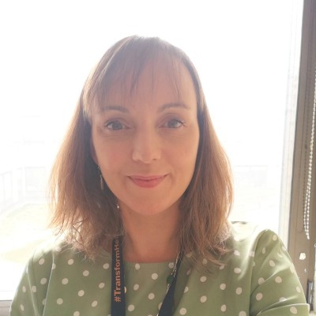

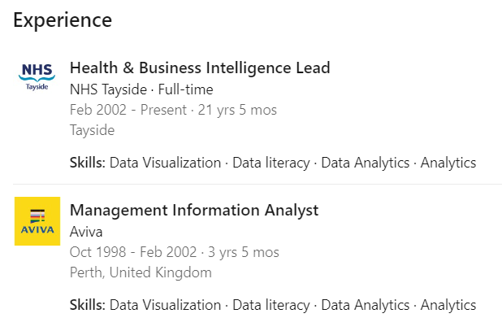
Who am I?
Jenni Woods
Health & Business Intelligence Lead

Slide 3

Health & Business Intelligence Team –
what do we do?
Reporting on patient activity and waiting times
Supporting strategic priorities, planning and direction of NHST
Analysis of reporting to help provide insight and intelligence
Communication and collaboration with key stakeholders
Focus on data visualisation to aid
interpretation
Assistance in helping improve data literacy
Development of intuitive dashboards
Personal development and discovery

Slide 4


Our Aim:
By doing what you love, you inspire and awaken the hearts of others.
Believe in yourself and you will be unstoppable.
Bring curiosity, creativity, and critical thinking.

Slide 5

HBI Principles:
4 truths in the world of data and information
right data
at the right time
for the right need
with the right data literacy
Reduce focus on noise / large volume of data, and focus on the objective you’re trying to achieve, find the right data for it, at the right time, and then bring data literacy to the table.

Slide 6
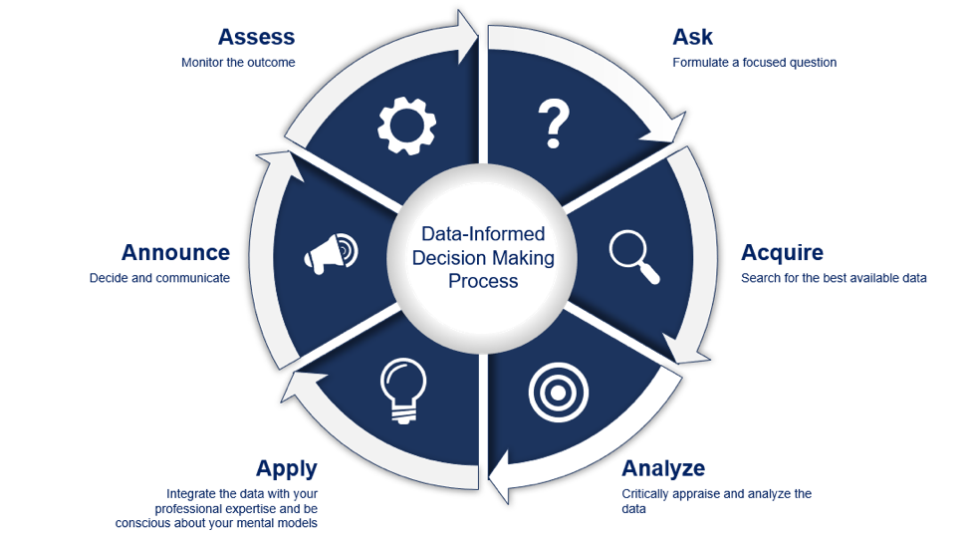

The data driven framework
Notes:
Ask
• This is the starting point
• Take time out to think and ask good questions
Acquire
• The power of a good data foundation
• Get to know the technical teams
• Two-way street – Asking and listening
Analyse
• 4 levels of analytics
Apply
• Don’t forget the human element
• Really get to know your associates and fellow leaders’ skills
Announce
• You have to make the decision!
• You need to lead people know and get them involved
• Harness the power of data storytelling
Assess
• Iterate…iterate…iterate
• Assess -> Evaluate -> Go again…

Slide 7

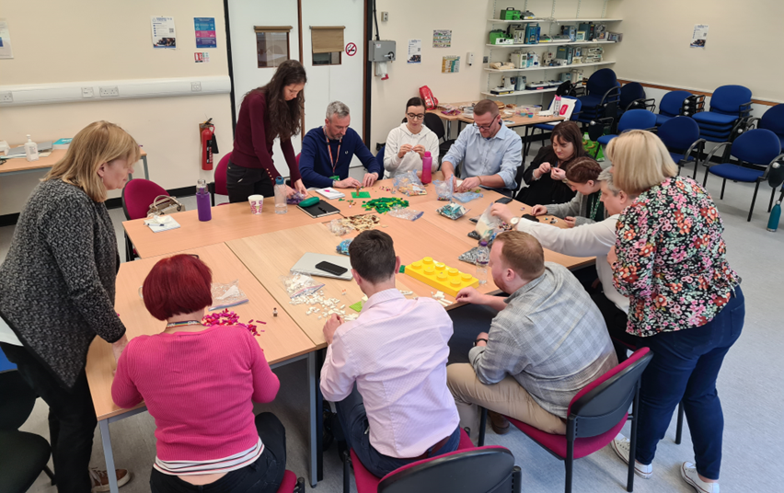
Our World of Data – the 4 C’s
Curiosity
Creativity
Critical Thinking
Confidence

Slide 8

Communication issued on Friday 6th March 2020 16:25
Per annum:
Admissions:
85,600
Outpatient Attendances:
1,052,000
Planned Diagnostic Tests:
82,000
Operational decisions to be made:
Cancellation of planned services including outpatient appointments, surgery admissions, diagnostic tests
All impact required reporting

Slide 9
NHS Tayside Covid table-top exercise Tuesday 10th March 2025
Digital acceleration to allow remote working – supporting both virtual consultations and admin tasks.
Where to prioritise the digital capabilities?
Demand, Capacity, Activity, Queue (DCAQ) analysis –
Data required for decision-making to target specialties most in need for emergency and urgent care.
Acute care, community, mental health.
List of patients with contact details.
Appointments booked / unbooked.
Volumes waiting.

Slide 10
Scottish Government Covid 19 Management Information request Monday 16th March 2025
Cease all irrelevant regular reporting
Create new dataset with collaboration across SG, Public Health Scotland and National Information Leads
Pull on the cumulative reporting and analytical skills available
Modelling – resource requirement
Covid – patient alerts
Urgent and Cancer Cases – vetted priorities
Resource requirements
Beds
Theatres
Staffing
Clinics

Slide 11
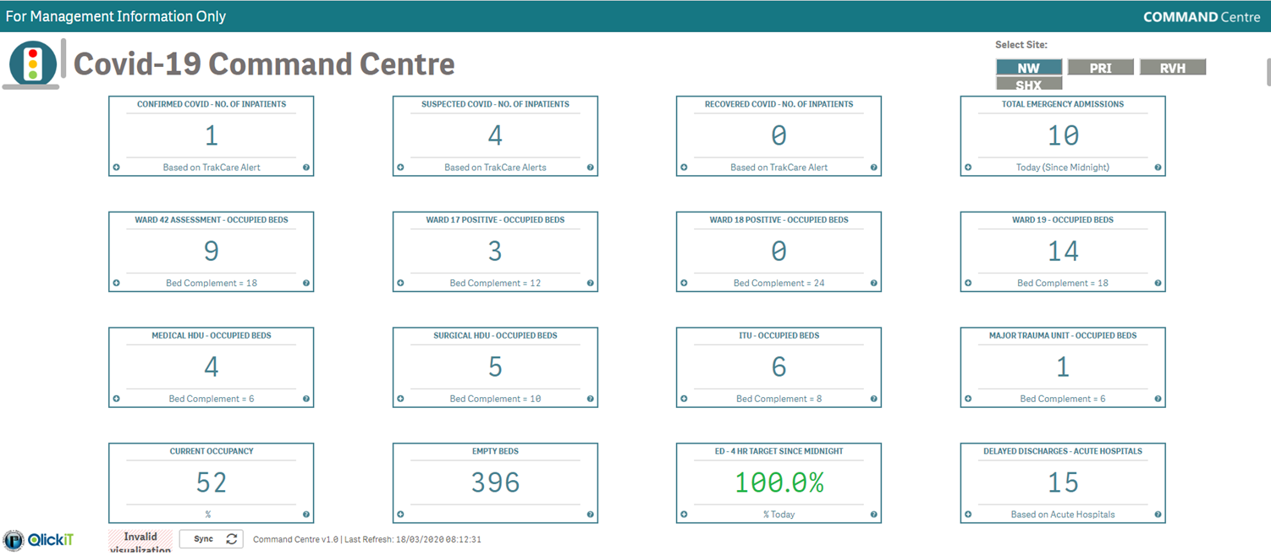
Covid-19 Command Centre – as at Wednesday 18/03/2020 09:00

Slide 12
Key areas of focus
Data input
Data quality
Data literacy
Data visualisation
Sources of data – local patient administration systems, lab systems, The Courier, Open Data, PHS
Driven by an aim to increase visibility and awareness of data, with transparency, honesty and clarity.

Slide 13
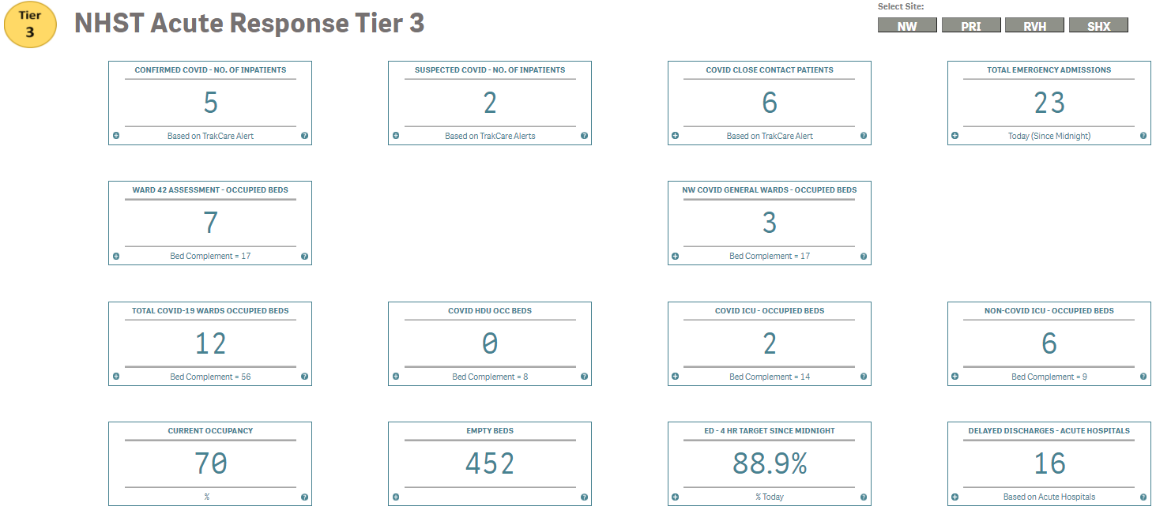
Covid-19 Command Centre – as at 18/03/2021 09:00
The following is a screenshot from the live Command Centre:
8
Total confirmed Covid-19 alert patients = 5. Total suspected Covid-19 alert patients = 2.
Total occupied Covid-19 beds = 12. Covid General Wards = 3, Covid HDU = 0, Covid ICU = 2
Ward Watcher Data
At Midnight:
 | Covid HDU | Covid ICU
VENT | 0 | 2
CPAP | 0 | 0
Other | 0 | 0

Slide 14
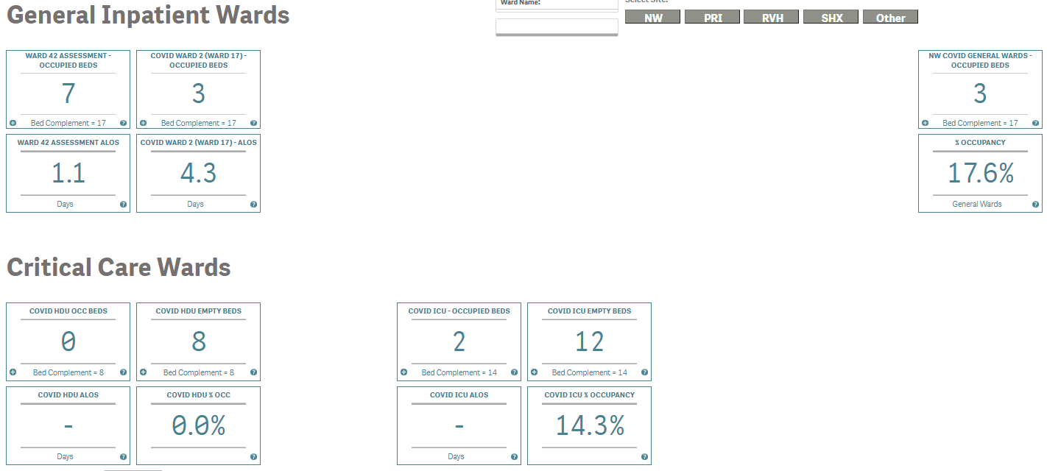
Covid-19 Covid Wards
The following is a screenshot from the live Command Centre:
The above information provides a live view of occupied beds and current average length of stay in days for active patients within Covid-19 wards across Ninewells Hospital.
13

Slide 15
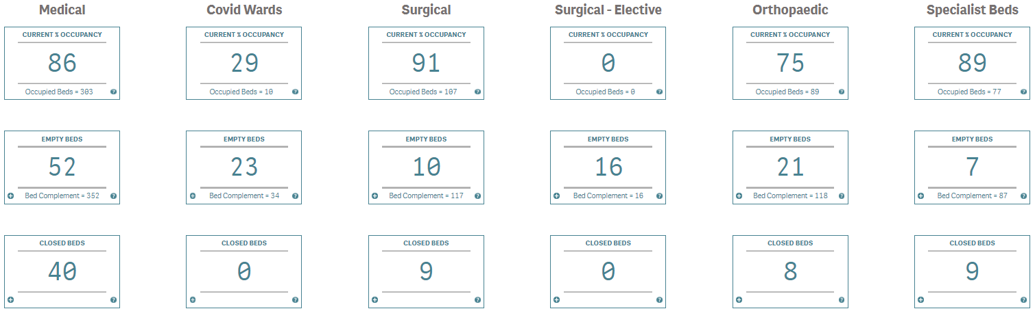
Command Centre – Ward Status - General
The following is a screenshot from the live Command Centre:
The above information provides a live view of % occupancy and current empty bed info for active wards across NHS Tayside, split by patient flow. Dedicated beds are those wards that have a dedicated function and are not available for general use e.g. emergency receiving, cancer, intensive, high dependency, endoscopy, palliative care.
3

Slide 16
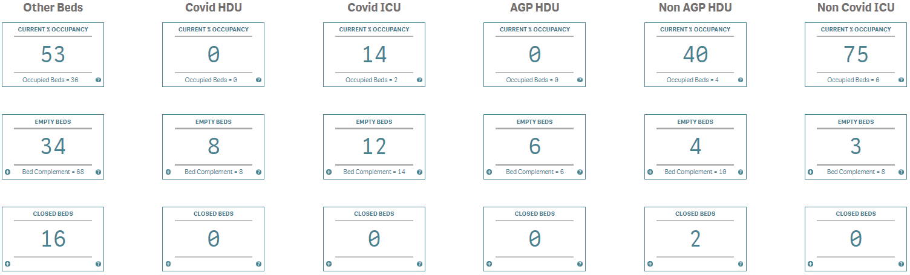
Command Centre – Ward Status – Critical Care
The following is a screenshot from the live Command Centre:
The above information provides a live view of % occupancy and current empty bed info for active wards across NHS Tayside, split by patient flow. Dedicated beds are those wards that have a dedicated function and are not available for general use e.g. emergency receiving, cancer, intensive, high dependency, endoscopy, palliative care.
3

Slide 17
Covid-19 Beds – % Occupancy
Position from 21st October 2020 onwards

Slide 18
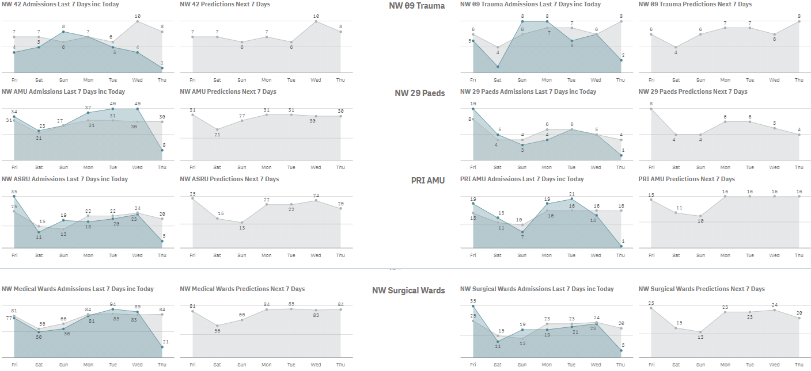

Command Centre – Hospital Daily Flow Predictions
The following is a screenshot from the live Command Centre:
The above information provides a live view of predicted admissions into receiving wards, including Ward 42 Covid Receiving Ward, across Ninewells Hospital for the previous 7 day period inclusive of today, and in to the next 7 days. Blue = Actual. Grey = Predicted. The predictions are based on average admissions recorded at same point across the preceeding 6 weeks. The bottom graphs provide a summary of all Medical and Surgical receiving wards.
14

Slide 19
NHS Tayside Heat Map Activity Level Tracker
Whole System Summary –
• GP/OOH = activity volumes at a fairly comfortable level. Continuing to monitor the Covid Community Rate and GP staffing levels.
• Acute = continual reduction in Covid occupancy and bed base, with static position across Non-Covid ward areas. Ongoing bed closures and additional capacity being created to allow for safe planned care admissions and the ability to aid re-mobilisation.
• H&SCPs = Angus, Dundee and P&K all at activity level 2 (Hot Green) RAG status. Staff shortages and bed closures creating ongoing pressures for step-down care. Delayed discharge volumes within the Acute setting have reduced slightly to 17 patients.
• Workforce = Covid staff absence an ongoing pressure throughout the system and being managed proactively.

Slide 20
Covid-19 Beds – Occupancy at Midnight

Slide 21
Covid-19 Beds– Occupancy at Midnight
Position from 1st October 2020 onwards

Slide 22
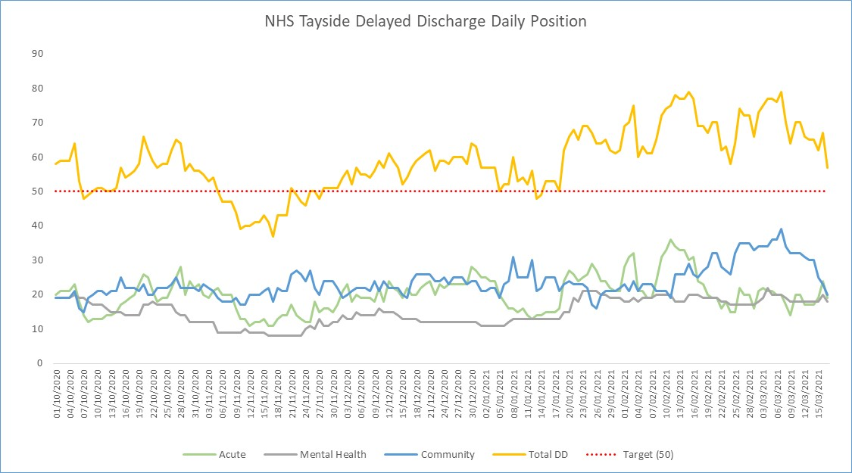
NHS Tayside Delayed Discharges
To 17/03/2021

Slide 23
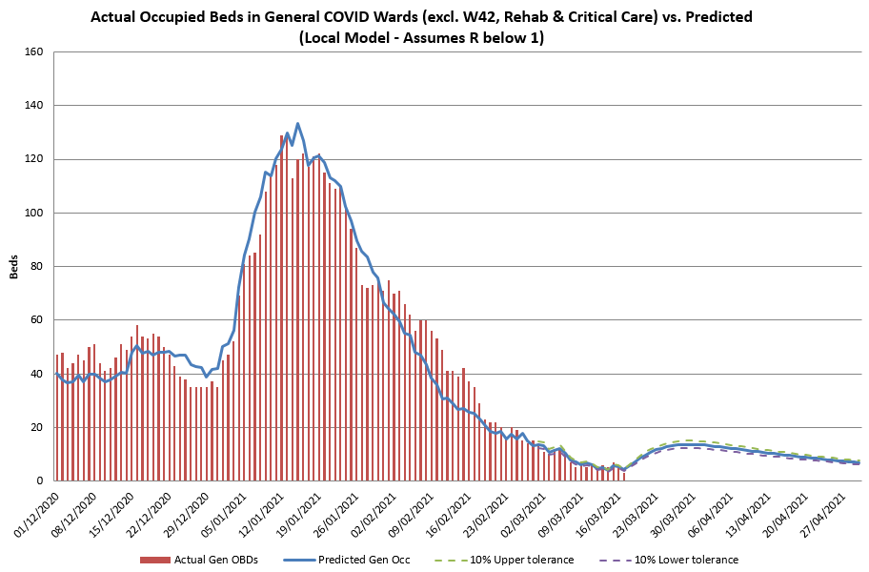
Latest Local SEIR Model General COVID IP

Slide 24
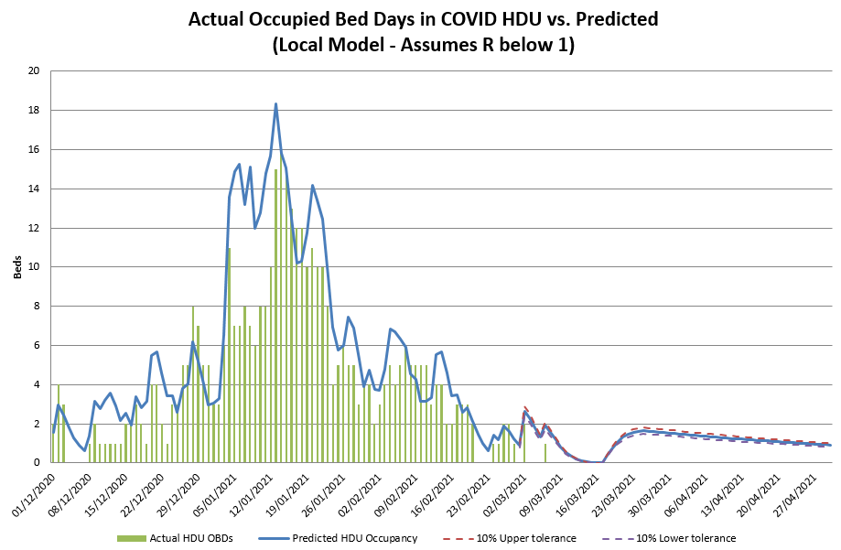
Latest Local SEIR Model COVID HDU

Slide 25
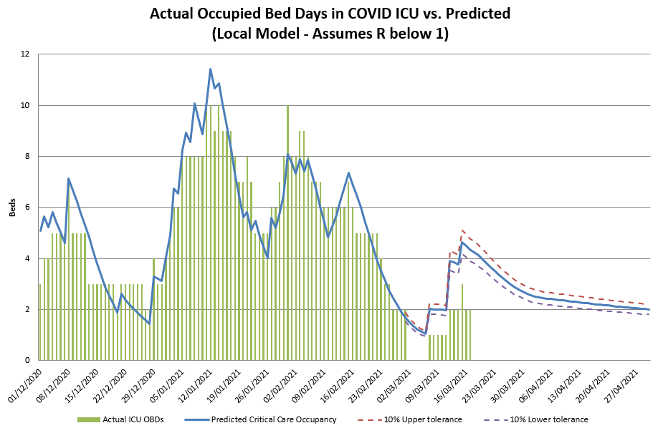
Latest Local SEIR Model COVID ICU

Slide 26
Local Model
Updated 1 March 2021 based on actual admissions up to 28/02
Assumes a hospitalisation rate of c4%
Median LOS for General IPs of 3 days
Median LOS for ICU of 9 days, but max set at 23 days
R below 1 from 14/01
Includes a 10% tolerance to all predictions
Model automatically refreshes daily based on actual admissions experienced
Points to note: Model is only focused on patients needing Acute COVID treatment in a designated COVID general ward, HDU or ICU. It does not include COVID Rehab wards, Ward 42 or any positive patients being treated out with the acute COVID bed base (i.e. patients in community or mental health hospitals)

Slide 27
Summary
Lots to learn as we went
Products built, reviewed and evaluated at pace
Collaboration across reporting groups where possible
Visibility and transparency of data was key
Looked to sources beyond traditional systems
Keep it simple where possible to ensure messages clear to allow decision-making at pace

